Slide 1
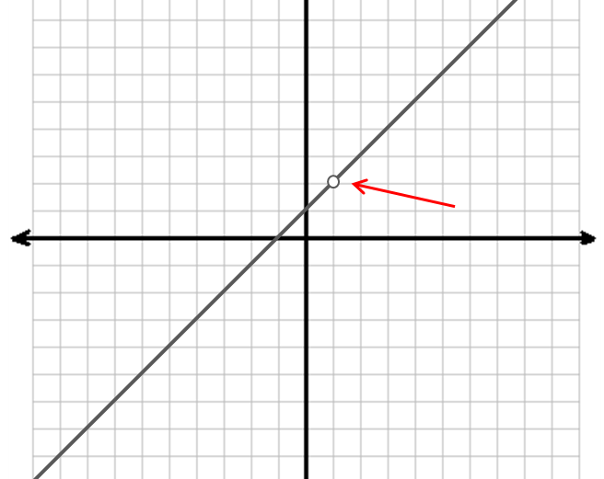
Objective: You will be able to identify intercepts, holes, asymptotes, and the domain for a rational function.
Rational Functions
A rational function we saw this summer

Slide 2
Intercepts
y-intercepts:
occur when x = 0 (intercept the y-axis). Sub-in 0 for x in the simplified function, then solve.
x-intercepts:
occur when y = 0 (intercept the x-axis). Set the top = 0 in the simplified function, then solve.

Slide 3
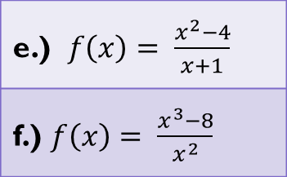
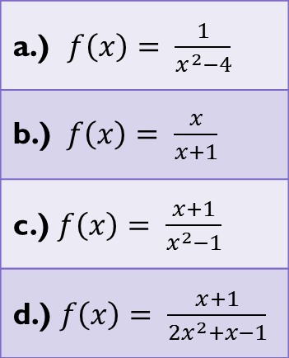
Examples: Intercepts
a.) $f\left(x\right)= \frac{1}{x^{2}−4}$
b.) $f\left(x\right)= \frac{x}{x+1}$
c.) $f\left(x\right)= \frac{x+1}{x^{2}−1}$
d.) $f\left(x\right)= \frac{x+1}{{2x}^{2}+x−1}$
e.) $f\left(x\right)= \frac{x^{2}−4}{x+1}$
f.) $f\left(x\right)= \frac{x^{3}−8}{x^{2}}$

Slide 4
Follow these steps…
Factor the numerator and denominator of the function.
Identify expressions in numerator and denominator that are the same.
Set this expression = 0, and solve. This is the x-value of the hole.
Sub the x-value into the simplified function. The result is the y-value of the hole.

Slide 5
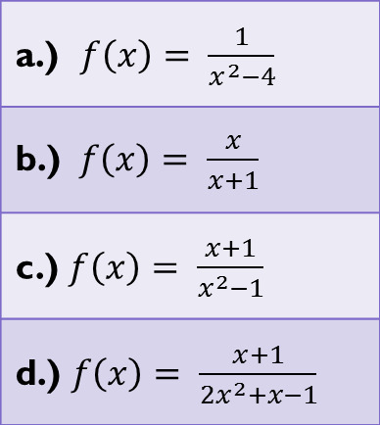
Examples: Find the Holes
Find the holes for each function.
a.) $f\left(x\right)= \frac{1}{x^{2}−4}$
b.) $f\left(x\right)= \frac{x}{x+1}$
c.) $f\left(x\right)= \frac{x+1}{x^{2}−1}$
d.) $f\left(x\right)= \frac{x+1}{{2x}^{2}+x−1}$

Slide 6
Do Now
Find the intercepts and holes for the function:
$$f\left(x\right)= \frac{x−4}{x^{2}−16}$$

Slide 7
Objective: You will be able to identify asymptotes and the domain for a rational function.
Rational Functions
A rational function we saw this summer

Slide 8
Asymptotes
Three cases for which to test:
VA: Set the denominator of a simplified function = 0, and solve.
HA: If the degree of the denominator is greater than the numerator, y =0. If the degree of the denominator = degree of the numerator, y = the ratio of the coeffients of terms with the greatest power

Slide 9
Asymptotes
Three cases for which to test:
SA: If degree of the top = 1 + degree of bottom, divide the top by the bottom. SA is y = nonremainder part.

Slide 10
VA: Examples
a.) $f\left(x\right)= \frac{1}{x^{2}−4}$
b.) $f\left(x\right)= \frac{x}{x+1}$
c.) $f\left(x\right)= \frac{x+1}{x^{2}−1}$
d.) $f\left(x\right)= \frac{x+1}{{2x}^{2}+x−1}$

Slide 11
HA: Examples
a.) $f\left(x\right)= \frac{1}{x^{2}−4}$
b.) $f\left(x\right)= \frac{x}{x+1}$
c.) $f\left(x\right)= \frac{x+1}{x^{2}−1}$
d.) $f\left(x\right)= \frac{x+1}{{2x}^{2}+x−1}$

Slide 12
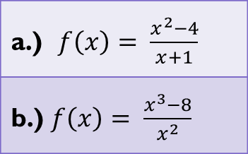
SA: Examples
a.) $f\left(x\right)= \frac{x^{2}−4}{x+1}$
b.) $f\left(x\right)= \frac{x^{3}−8}{x^{2}}$

Slide 13
Domain
For all rational functions:
$$\left\{x | x≠VAs\right\}$$
where VAs are each of the x-intercepts of the vertical asymptotes.

Slide 14
Examples: Domain
a.) $f\left(x\right)= \frac{1}{x^{2}−4}$
b.) $f\left(x\right)= \frac{x}{x+1}$
c.) $f\left(x\right)= \frac{x+1}{x^{2}−1}$
d.) $f\left(x\right)= \frac{x+1}{{2x}^{2}+x−1}$
e.) $f\left(x\right)= \frac{x^{2}−4}{x+1}$
f.) $f\left(x\right)= \frac{x^{3}−8}{x^{2}}$

Slide 15
Recap…
To find the holes of a function:
Factor the rational expression
ID common factors in the top/bottom
Set these equal to 0 and solve.
Sub the x-value into the simplified expression to find the y-value.

Slide 16
Recap…
To find the intercepts of a function:
Simplify the rational expression.
Y-int: Let x = 0, substitute, and solve for y.
X-int: Set numerator = 0, and solve for x. y = 0.

Slide 17
Recap…
To find the vertical asymptotes of a function:
Simplify the rational expression.
Set the denominator equal to 0.
Solve for values of x.

Slide 18
Recap…
To find the horizontal asymptotes of a function:
ID the terms with the greatest power in the numerator and denominator.
Put these in the ratio N/D.
If the degree of N < degree of D, then y = 0
If the degree of N = degree of D, then y = ratio of coefficients of the terms with the greatest powers.
If the degree of N > degree of D, then the asymptote may be a slant asymptote.

Slide 19
Recap…
To find the slant asymptotes of a function:
The function has no horizontal asymptote.
If the degree of N = degree of D + 1, then the asymptote will be a slant asymptote.
Divide N by D.
Y = the quotient (not the remainder).

Slide 20
Recap…
To find the domain of a function:
ID the x-values of the vertical asymptote(s) and the hole(s).
Domain for a rational function is all reals except where vertical asymptotes and holes live.

Slide 21
Exit Pass
Find the intercepts, holes, asymptotes and domain for the function:
$$f\left(x\right)= \frac{x^{2}−4}{2x^{2}}$$

