Slide 1
Do Now
Find the holes, asymptotes, intercepts, and domain for the following function:

Slide 2
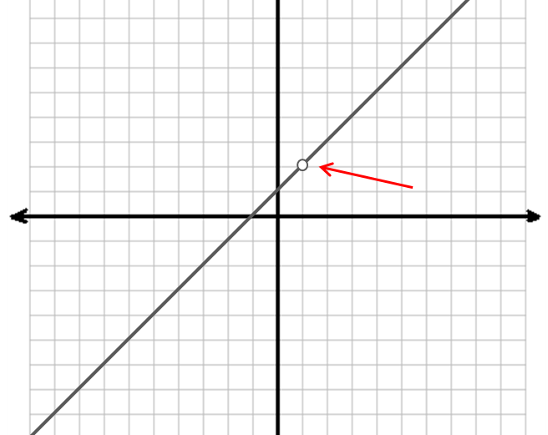
Objective: You will be apply a sign analysis of rational functions and sketch rational functions.
Rational Functions
A rational function we saw this summer

Slide 3
Sign Analysis
A method to determine where the function lives (above, on, or below the x-axis)…
Steps:
Find the x-intercepts and the asymptotes.
Write these numeric values in order from least to greatest on a number line.
Intercepts = closed circle/dot
Asymptotes = open circle
Test the intervals. Label positive with + and negative with -.

Slide 4
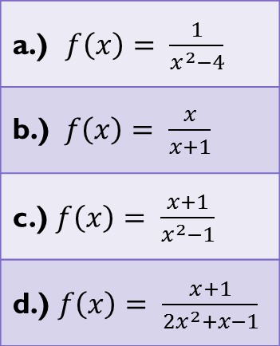
Examples: Sign Analysis

Slide 5
Sketching Rational Functions…
Follow these steps…
Find the holes, intercepts, and asymptotes for the function.
Apply a sign analysis.
Plot the holes and intercepts; draw-in the asymptotes.
Use steps 2 and 3 to sketch the function.
(Check yourself by using a graphing calculator.)

Slide 6
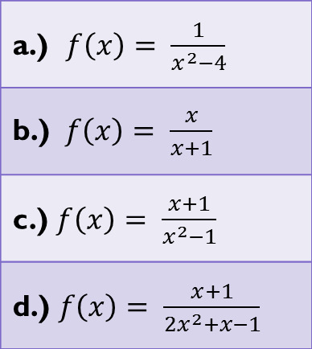
Examples: Sketching
Find the holes for each function.

Slide 7
Exit Pass
Find the intercepts, holes, asymptotes and domain for the function:
$$f\left(x\right)= \frac{x^{2}−4}{2x^{2}}$$

