Slide 1
Do Now!
Given the equation, f(t) = 48 +32t – 16t²,
which represents the height of a ball thrown into the air, where t = time in seconds.
Find the height of ball at these times: t = 0, 1, 2, 3, 4

Slide 2
Numerical and Graphical Limits
HW:
pp. 54-55: 3-7 odd, 9-13 odd, 17-31 odd opt: 57, 59
Video: Binomial Expansion
You will be able to find the limit of a function numerically and graphically.

Slide 3
A “Working” Definition
The limit of f(x) is L as x approaches a, provided that we can make f(x) as close to L as we want for all x sufficiently close to a, from both sides, without letting x be a.
Written as:
$$\lim_{x→a}{f\left(x\right)=L}$$
Possible limit values:
A number
DNE


Slide 4
When do limits fail (to exist)?
Left  Right
Oscillates
Increases without bound

Slide 5
Find limits numerically
$$\lim_{x→2}{\frac{x^{2}−3x+2}{x−2}}$$
Turn-on your graphing calcs and follow these steps:
1.) Press Y=. Input the function on the first line.
2.) Press 2nd WINDOW.
3.) Change “INDPNT” to “ASK.”
4.) Press 2nd GRAPH. Input each of the values listed above for x. Press ENTER for each. The result is the resulting f(x) value.

Slide 6
Find limits numerically
$\lim_{x→2}{\frac{x^{2}−3x+2}{x−2}}$ =
1
The limit of f(x) as x approaches a is not necessarily equal to f(a).
Limits are an approached y-value, they are not the defined y-value at a point.

Slide 7
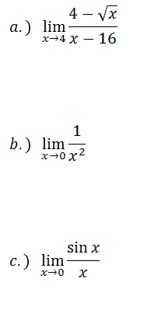
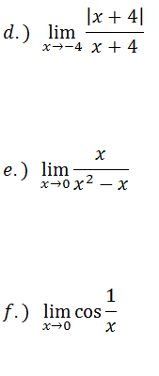
Follow-Ups
Find the limit of these functions numerically

Slide 8
Recap…
On the previous slide, we found the limit of the function from:
the left side of a; and
the right side of a.
Notation:
$\lim_{x→a^{−}}{f(x)}$ means “the limit of f(x) as x approaches a from the left.”
$\lim_{x→a^{+}}{f(x)}$ means “the limit of f(x) as x approaches a from the right.”

Slide 9
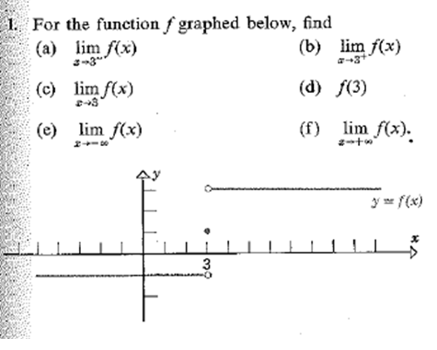
Find limits graphically

Slide 10
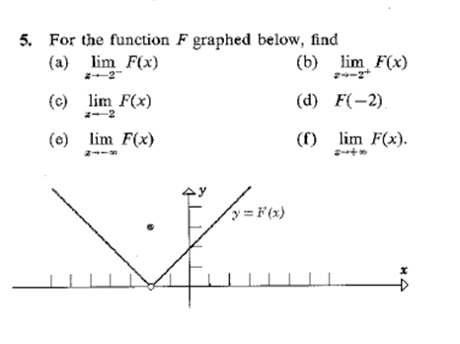
Find Limits graphically

Slide 11
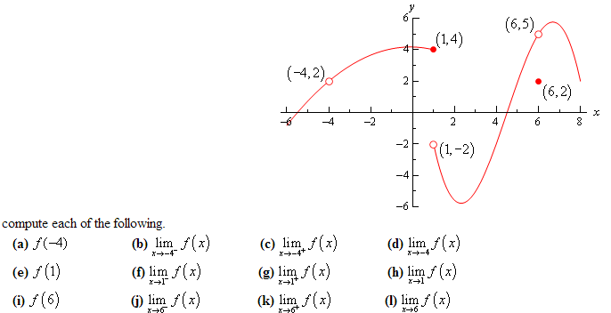
Follow-up
Find the limit of this function graphically.

Slide 12
Exit Pass
Find the limit of $f\left(x\right)=\frac{x^{3}−1}{x+1}$ as x approaches -1.

